Slide 1
Classroom Management & Motivation

Slide 3
They learn *with research based methods ( they want to cretae their learning styles ) *when they value information when it is relevant & timely * when there isn’t an authoriterian teaching , authoriterian teaching is ineffective * when there is a relaxed & warm empathetic class environment *good rapport , they learn better when there is a bond with the lecturer

Slide 4
Millenials ; *have short attention span *are comfortable using techonology *prefer interactive & collaborative learning *are good at multitasking *are visual & auditory learners

Slide 5
http://www.educationplanner.org/students/self-assessments/learning-styles.shtml

Slide 7
Fixed Mindset

Slide 8
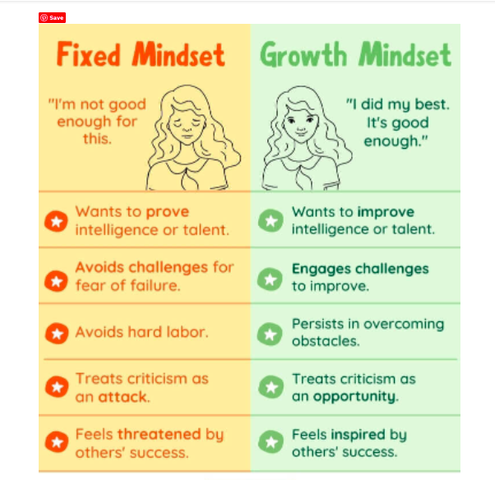

Slide 9
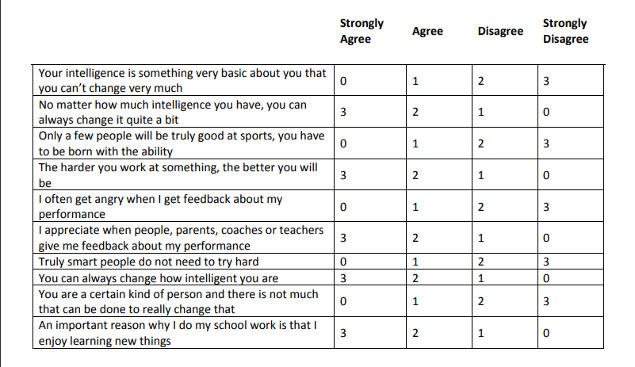
SCORE CHART
22-30 = Strong Growth Mindset
17-21 = Growth with some Fixed ideas
11-16 = Fixed with some growth ideas
0-10 = Strong fixed mindset

Slide 10
WHAT IS MOTIVATION?

Slide 13
Learners who are intrinsically motivated are more likely to do better academically and therefore as teachers our goal is to try and help our students to develop their internal motivation.”

Slide 14
Internally motivated students are ; *Interested *Curious *Focused *Enthusiastic *Eager *Passionate *Optimistic *Full of effort
But how ?

Slide 15
We should promote *trust , empathy and acceptance *group cohesiveness *collaboration *shared repsonsibility

Slide 16
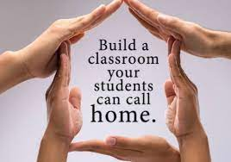
In order to be able to fully engaged and be motivated in class , learners need to feel that the group is important to them , that they are important to the group and that they will be cared for and supported ( safe learning environment )

Slide 17
“Studies have shown that when learners work in groups it leads to improved achievement , retention of learning and social relationship , as well as , increasing intrinsic motivation . It can lessen the stress of contributing in a whole- class situation and give more free time for learners to work at their own pace “ Fredericks , 2014

Slide 18
Benefits of peer teaching *engages and motivates learners *increases all student participation * fosters interpersonal skills – collaboration , trust , understanding & empathy *makes learning more memorable * peer teachers reinforce their own learning

Slide 19
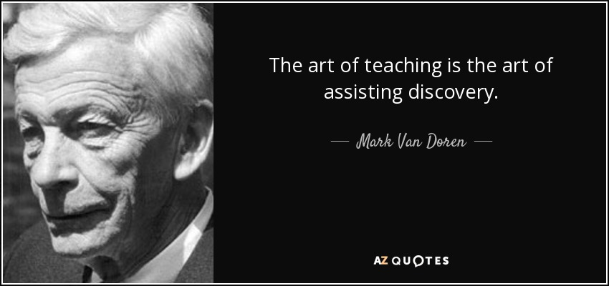
”The art of teaching is the art of assisting discovery “ Mark Van Doren

Slide 20
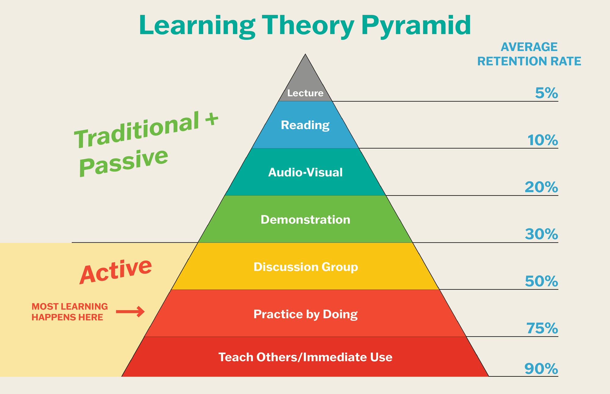
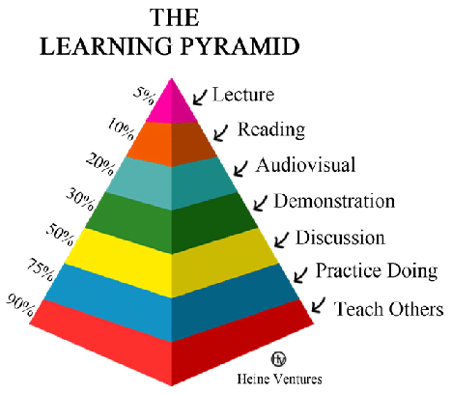

Slide 21
Make learning more meaningful, personal , relevant & real world
”Students are motivated and engaged in content and activities when they can build on prior knowledge and draw clear connections between what they are learning and the world they live in “

Slide 22
“Real world content and culture is a very powerful hook . It can heighten the interest and motivation of your students . It becomes an exciting educational experience “

Slide 23
According to Fraser, “ When students own their learning and feel responsible for it we tap into the most powerful reservoir of potential , only then they tend to be fully engaged , motivated and willing to learn “

Slide 25
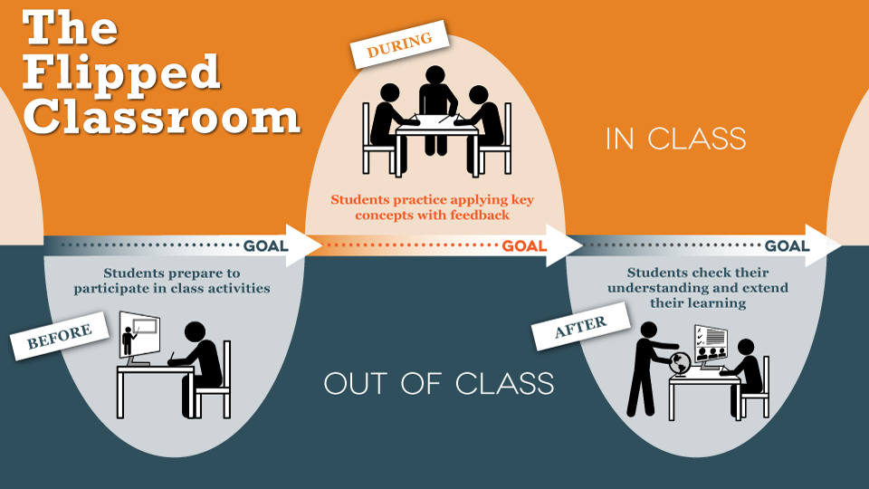
Flipped classroom

Slide 26
Flipped classroom * develops learner autonomy * provides a more personalised learning experience *facilitates differentiation * gives more flexiblity * more student centered classes * allows more communication – rich clases

Slide 27
Students love to have choices. Choice gives them a sense of empowerment over their learning environment & helps them keep engaged .

Slide 28
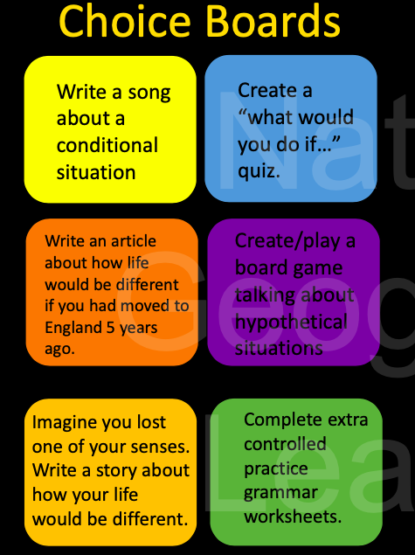
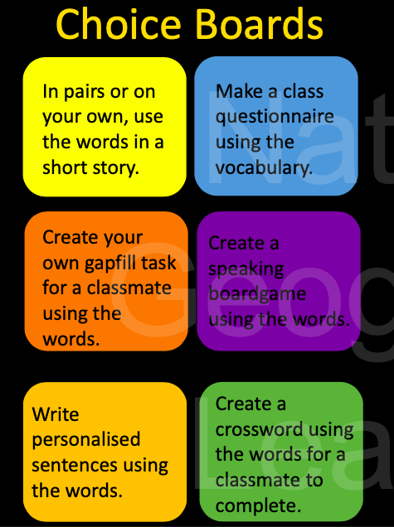
How can we give choices to our students ?

Slide 29
” Motivation is one of those things like justice or world peace ;we all know it is a good idea but it is not quite so clear how to get there “ Tim Ward

